Slide 1
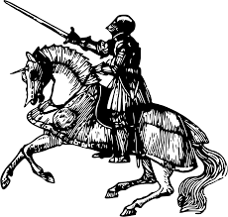
Conquering
Difficult Texts
You can read pretty much anything
(If you put your mind to it :) )

Slide 2
Reading Strategies
Previewing- Using titles, section headers, and other visuals cues to understand the context and location of the text
Using Context clues- Looking at the hints the author gives to better understand pieces of a selection that you don’t understand
Paraphrasing- Going through and putting the text in your own words (In Shakespeare, it helps to paraphrase every one to two lines)
Pulling from Prior Knowledge (or Google’s knowledge)- What do you know about the text (the time period, the vocabulary, etc.)? What do you want to know that the internet could help you with?

Slide 3
Reading Strategies (Cont.)
Thinking about your Thinking- Where do you not understand? Why? Is it the order of words that confuse you? Is it a word itself that confuses you? (Understanding how YOU think will help you look at your own strengths and weaknesses)
Rereading- No one understands EVERYTHING about a text the first time they read it, even expert readers. In fact, expert readers know that they have to reread MULTIPLE times to understand a text
Annotating- BREAK IT DOWN into manageable bits. Of course, reading a giant monologue is intimidating. Think of it as a lot of little sections instead.
Generating Questions- What do YOU want to know? Where can you find it?

