Slide 1
Academic Writing Skills Crash-Course

Slide 2
Integrating quotes
When integrating quotes, you must:
Introduce or explain the quote: you have to explain the quote, telling the reader why you are using it. Great student examples:
At this point in Grendel’s life he was wandering through the woods thinking about his place in the world. As Grendel entered the cave of the dragon, the dragon said “‘We’ve been expecting you’” (Gardner, 58).
The dragon even pointed out Grendel’s childishness, causing Grendel to reflect on his own naivete: “In some way I couldn’t explain, I knew that his scorn of my childish credulity was right.” (Gardener, 75).
DO NOT SIMPLY DROP IN THE QUOTE.
See handout for additional help

Slide 3
Go to your current draft
Identify three quotes.
Do you introduce them? Are thy MLA formatted with in text citations and block quoted if needed? Are quotes within quotes formatted correctly? Do you explain them?
Edit the three quotes you identified. Have a peer check them.
After your peer has checked them, have Ms. Peel look over them :)

Slide 4
MLA Formatting
Group 1: What does the overall MLA formatting look like? What is the font and size? How are the lines spaced? What does the header look like? Where does the title go?
Group 2: What does the works cited page look like? What order do the citations go in? What does a general book citation look like? Website? Journal? Interview?
Group 3: What are in-text citations? Where do they go? How are they formatted?
Group 4: What are block quotes? When do you use them? How are they formatted differently from other quotes?
Group 5: When quoting different works, do you format poetry different than prose? If so, what are the main differences? How are poems formatted differently in block quotes than prose?

Slide 5
MLA Pointers
Found by YOU at Purdue OWL
Group 1:
Group 2:
Group 3:
Group 4:
Group 5:

Slide 6
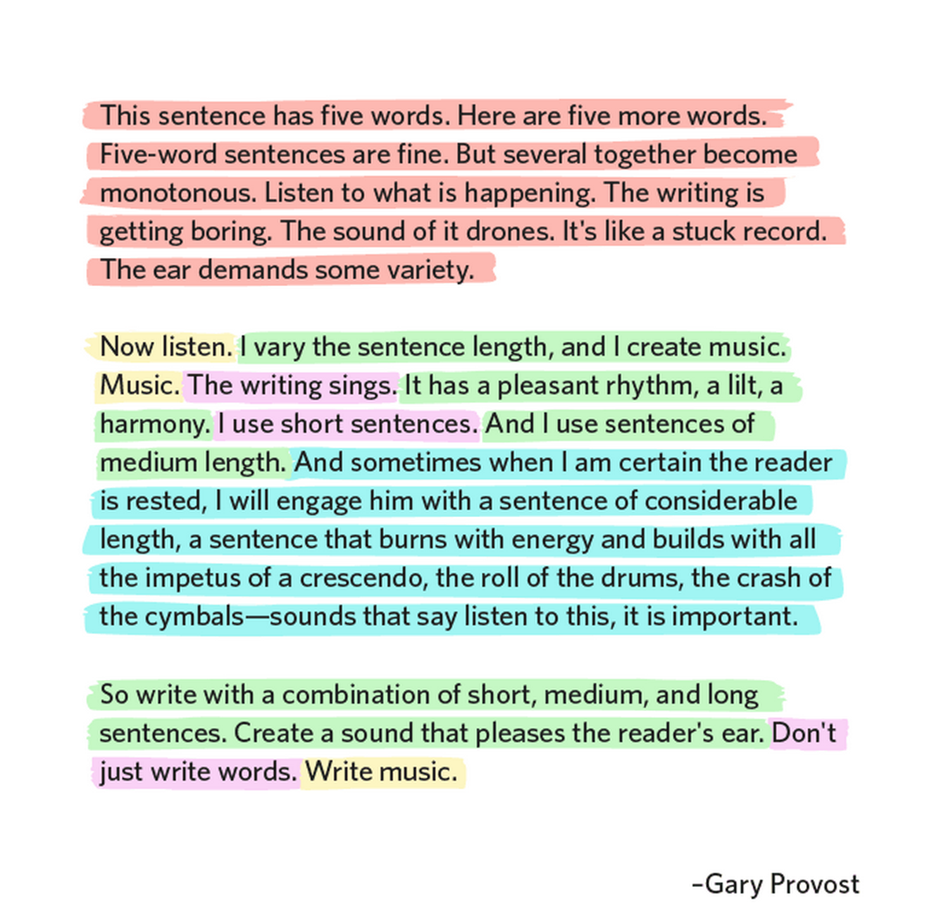

Slide 7
Academic Tone
Tone refers to the writer's voice in a written work. It is what the reader or hearer might perceive as the writer's attitude, bias, or personality. Many academic writers mistake a scholarly tone for dull, boring language or a mixture of jargon and multisyllabic, "intelligent-sounding" words. Academic writing, however, does not need to be complicated nor lacking in style; instead, it can be both engaging and clear.

Slide 8
Awesome Student Example
The lack of guidance and companionship throughout Grendel’s childhood sparked his frustrations. He constantly sought companionship and help from his mother, and although she cared for him, she never delivered. Grendel says early in the novel that
When her strange eyes burned into me, it did not seem quite sure. I was intensely aware of where I sat, the
volume of darkness I displaced, the shiny-smooth span of packed dirt between us, and the shocking
separateness from me in my mama’s eyes. I would feel, all at once, alone and ugly, almost—as if I’d dirtied
myself—obscene (Gardener, 17).
He displays his dissatisfaction with the way his mother treats him here. She was distant, and made him feel wrong. This lack of guidance made him out to be a naive and socially strange adult.

Slide 9
Characteristics of Academic Tone
You should speak as an objective social scientist. This means that everything you say must be unbiased, scholarly, and supported by evidence. According to APA (2010), "arguments should be presented in a non combative manner" (p. 66).
Avoid using personal pronouns “I,” “you,” “we,” etc.
Avoid making broad generalizations (always and never).
Avoid using over-sweeping adjectives (outstanding, obvious).
Avoid using adverbs (really, clearly).
Avoid qualifiers (a little, definitely).
Avoid emotional language (It is heartbreaking that so many are starving).
Avoid inflammatory language (Smith's study was terrible, sickening, sad).
OVERALL, LANGUAGE MUST BE PRECISE AND CLEAR

Slide 10
Editing for Precise Language
Torture was definitely a usual thing that occurred when humans were in the presence of Grendel, an obvious monster.
Being by himself for a long time, I think that it makes sense that Grendel would tend to think for himself and feel as though he was responsible for his own actions because how else could a poor, lonely child grow up?
There is only one way to characterize Grendel, and that is as always evil. From all of his heart-breaking actions that he does throughout the book he does it in an evil manner.

Slide 11
Open your journal or grab one paragraph from your current draft
Underline anywhere you use unnecessary words
Circle anywhere you put yourself into the work “I,” “we,” “my,” “In my opinion,” “I believe,” “When I first saw/read…”
Box anywhere you use emotional language (language that looks for pity, sympathy, etc. Ex: “Baby monster Grendel”)
After you have done so, rewrite your paragraph to exclude those phrases.
Have a peer check it, then have Ms. Peel check it
THIS WILL GO IN THE GRADE BOOK

Slide 12
Thesis Statement Reminders
A thesis:
tells the reader how you will interpret the significance of the subject matter under discussion. is a road map for the paper; in other words, it tells the reader what to expect from the rest of the paper.
directly answers the question asked of you. A thesis is an interpretation of a question or subject, not the subject itself.
The subject, or topic, of an essay might be World War II or Moby Dick; a thesis must then offer a way to understand the war or the novel.
makes a claim that others might dispute.
is usually a single sentence near the beginning of your paper (most often, at the end of the first paragraph) that presents your argument to the reader. The rest of the paper, the body of the essay, gathers and organizes evidence that will persuade the reader of the logic of your interpretation.

